Slide 1
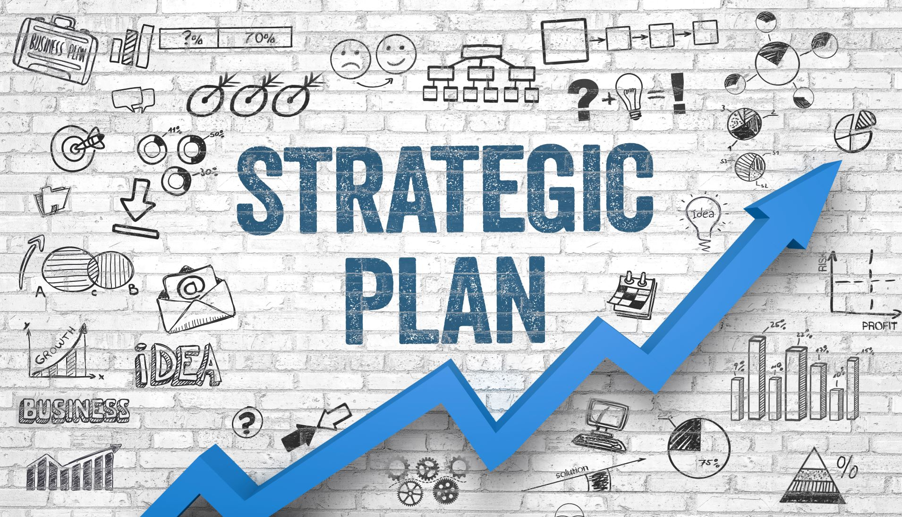
Work Plan
Data Integration:
Merge sales and sensor data based on common identifiers, such as product IDs and timestamps, to create a unified dataset for analysis.
Feature Engineering:
Create relevant features from the integrated dataset, including hourly sales, temperature variations, and stock levels, to capture important aspects of the data for modelling.
Model Development:
Time-Series Forecasting: Develop time-series models to predict hourly stock levels based on past sales data and sensor readings.
Machine Learning: Implement machine learning algorithms to identify key factors influencing stock levels and optimize procurement decisions.
Validation and Optimization:
Cross-Validation: Validate models using cross-validation techniques to ensure robustness and reliability.
Model Evaluation: Evaluate model performance based on metrics such as accuracy, precision, and recall.
Optimization: Continuously optimize models based on feedback and real-world performance to enhance stock level predictions.
Data Model
To solve the client's problem statement of accurately predicting stock levels based on sales and sensor data on an hourly basis, I propose the following strategic plan:

